Slide 1


On Becoming a Leader in Risk Management
Fundamentals of RM
RM System and Process
Leadership in RM
Incident Investigation
RM Tools & Challenges
RM in Industry
People & Org.
Applications & Perspectives
ENGG404 – Lecture
Chapter 6.3: Occupational Health & Safety Regulatory Framework in Canada
Note to Students: The Student’s Version of this PPT contains more slides and information than is presented in the lecture. It is expected that you understand this information in order to give you a base of understanding for other topics in this lecture.
1
Notes:
ENGG404 Lecture 00 - Day 1
2012 Fall
1
1

Slide 2
Learning Outcomes:
Explain the history of OH&S in Canada
Explain applicable OH&S legislation in Canada
Explain the responsibilities of Engineers and Managers under OH&S legislation
Analyse a case study to apply professional engineering OH&S responsibilities
Chapter 6.3: OH&S In Canada
2
Notes:
2

Slide 3
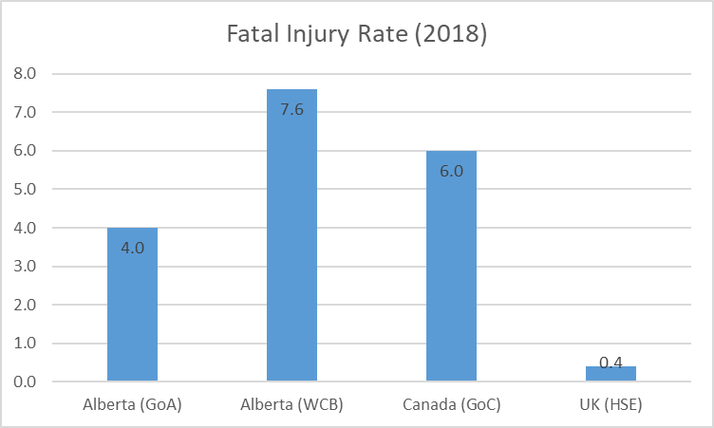
Safety Performance – A Comparison:
FIR = Fatal Injury Rate (work-related)
AB (WCB) includes long-term illnesses
Closest comparison is with UK – an order of magnitude lower. Why?
Chapter 6.3: OH&S In Canada

Slide 4
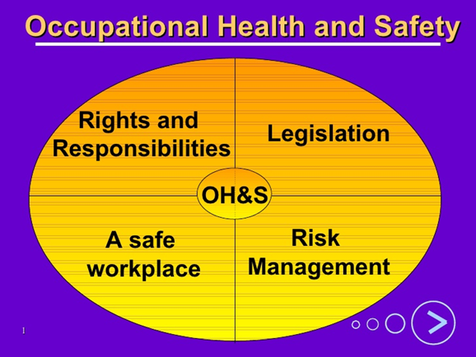
OH&S in Canada - Background:
So why is it important to understand the regulations for Occupational Health and Safety ?
They are mandatory by the Canadian legal system.
They set the minimum safety standards in the workplace.
They assign responsibilities to employers and employees in the workplace.
For example, it is a job requirement for managers to maintain certain rights and responsibilities of employees set out by these regulations.
They allow for enforcement, and set penalties for non-compliance.
Chapter 6.3: OH&S In Canada
4
Notes:
4

Slide 5
Hierarchy of Legislation in Canada:
Legislation
Statutory Law
Act
Overall Objectives of Legislation
Regulations
Implementations of specific objectives of the Act (Includes Code Adoption Documents)
Legal Codes
Technical specification and implementation details
Standards
Industrial/Country technical specification and implementation details
Canadian Criminal Code
Federal OH&S
Canadian Labour Code
Covers federal regulated workplaces, ~10% of workforce
Examples: federal employees, railways, airports
Alberta OH&S
Alberta OH&S Act/Regs/Code
Covers majority of Alberta workforce
OH&S penalties also under Alberta OH&S legislation
Chapter 6.3: OH&S In Canada
5

Slide 6
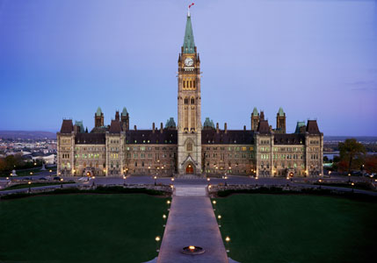
OH&S Legislation in Canada:
Legislation (or “statutory law") is law which has been enacted by a legislature or other governing body, or the process of making it.
In Canada, legislation or Acts are passed by the Parliament of Canada and by provincial legislatures.
Examples of OH&S legislation:
Canadian Criminal Code
Canadian Labour Code (only covers ~10% of Cdn workforce)
Parliament Building
Image: Parliament of Canada
Chapter 6.3: OH&S In Canada
6

Slide 7
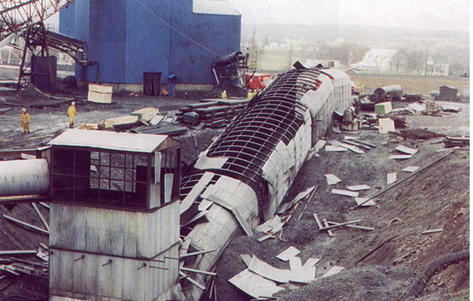
Westray Mine, A “Watershed Incident” - What Happened:
Methane-triggered coal dust explosion, 26 fatalities Plymouth, Nova Scotia (May 9, 1992)
Owned by Curragh Resources Inc.
“The most important thing to come out of a mine is the miner.” (Frederic Le Play, 1806-1882, French sociologist and inspector general of mines in France)
Chapter 6.3: OH&S In Canada
7
Notes:
Primary References
Richard, K.P., Justice, “The Westray Story – a Predictable Path to Disaster. Report of the Westray Mine Public Inquiry”, Province of Nova Scotia, Halifax, NS (1997).
Amyotte, P.R. and Oehmen, A.M., “Application of a Loss Causation Model to the Westray Mine Explosion”, Process Safety and Environmental Protection (Transactions of the Institution of Chemical Engineers, Part B), 80, 55-59 (2002).
Westray was an underground coal mine in Plymouth, Nova Scotia (just outside of New Glasgow). On May 9, 1992 a methane-triggered coal dust explosion occurred, resulting in twenty-six fatalities. The overpressures generated underground were powerful enough to result in damage at the surface, as we can see in this photograph from the public inquiry report (Richard, 1997).

Slide 8
Westray Mine Incident – Immediate Causes:
Substandard Work Practices:
Poor housekeeping with respect to build up of coal dust in mine
No effort to reduce make coal dust inert by adding rock dust
Continuation of mining in spite of inoperable methane detection devices
Storage of fuel and re-fueling of vehicles underground
Inadequate follow up by NS Gov’t inspectors to address regulatory deficiencies
Substandard Conditions:
Inadequate ventilation system design and capability
Thick layers of coal dust with unacceptably high levels of combustible matter
Inadequate system to warn
Chapter 6.3: OH&S In Canada
8
Notes:
With its poor working conditions, Westray was an incident waiting to happen. Inadequate mine ventilation resulted in methane concentrations that were consistently higher than those permitted by regulations. Coal dust accumulation levels were also high, and there was a lack of rock dusting (inerting of the coal dust with limestone or dolomite). As indicated in the slide, other standard practices were also occurring in the mine (Amyotte and Oehmen, 2002).

Slide 9
Westray Mine Incident – Basic Causes:
Engineering and Design Factors:
Poor regulating control of and maintaining air flow (inadequate technical design)
Job Factors:
Workers not engaged in day to day decision-making, just follow orders (organizational factors)
Unqualified personnel & poor employee training (inadequate training)
Poor compliance to best industry practices and legislated safety requirements (inadequate job procedures)
Personal Factors:
Fear of reprisal on part of workers (perceived mental or psychological stress)
Chapter 6.3: OH&S In Canada
9
Notes:
These substandard practices and conditions were a result of the lack of concern management had with respect to safety issues at the mine.
There was a poor safety culture at Westray, and production was prioritized at the expense of employee safety. Employees had a fear of reprisal, which undermined the possibilities for just and reporting cultures, and did not provide an opportunity for the existence of learning and flexible cultures.
Additionally, there was no effective safety management system at Westray. Employees generally had a lack of experience and knowledge of safe underground working practices. There was also a lack of safe work practices and procedures in place, indicating that employees were poorly trained.
Westray clearly demonstrates that a safety management system approach and the concept of safety culture go hand-in-hand when it comes to assuring worker safety (Amyotte and Oehmen, 2002).

Slide 10
Westray Mine Incident – Basic Causes:
Latent Causes were related to these RMEs:
Management Leadership, Commitment, and Accountability
Program Evaluation and Continuous Improvement
Design, Construction and Start-Up
Operations and Maintenance
Employee Competency and Training
Chapter 6.3: OH&S In Canada
10
Notes:
These substandard practices and conditions were a result of the lack of concern management had with respect to safety issues at the mine.
There was a poor safety culture at Westray, and production was prioritized at the expense of employee safety. Employees had a fear of reprisal, which undermined the possibilities for just and reporting cultures, and did not provide an opportunity for the existence of learning and flexible cultures.
Additionally, there was no effective safety management system at Westray. Employees generally had a lack of experience and knowledge of safe underground working practices. There was also a lack of safe work practices and procedures in place, indicating that employees were poorly trained.
Westray clearly demonstrates that a safety management system approach and the concept of safety culture go hand-in-hand when it comes to assuring worker safety (Amyotte and Oehmen, 2002).

Slide 11
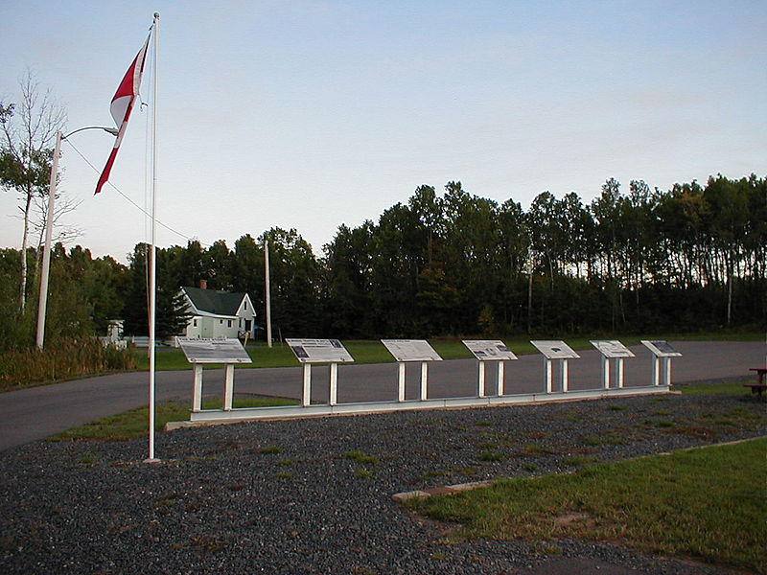
Westray Mine, A “Watershed Incident” - The Aftermath:
A public inquiry determined that the mine was mismanaged, miners' safety was ignored, and poor oversight by government regulators led to the disaster.
A criminal case against two mine managers went to trial but dropped by the Crown in 1998.
The mine was dismantled and permanently sealed in November 1998.
Westray Coal Mine (Nova Scotia)
Source: The Westray Story
Image: Wikimedia Commons
Chapter 6.3: OH&S In Canada
11

Slide 12
Westray Mine, A “Watershed Incident” - The Aftermath:
Due to the failure to successfully prosecute the mine’s owners and managers, the Canadian Labour Congress lobbied to amend the Criminal Code of Canada in order to hold managers criminally liable
In 2003, Bill C-45 was passed.
Corporate culture change driven by legislation!
Westray Coal Mine (Nova Scotia)
Source: The Westray Story
Image: Wikimedia Commons
Chapter 6.3: OH&S In Canada
12

Slide 13
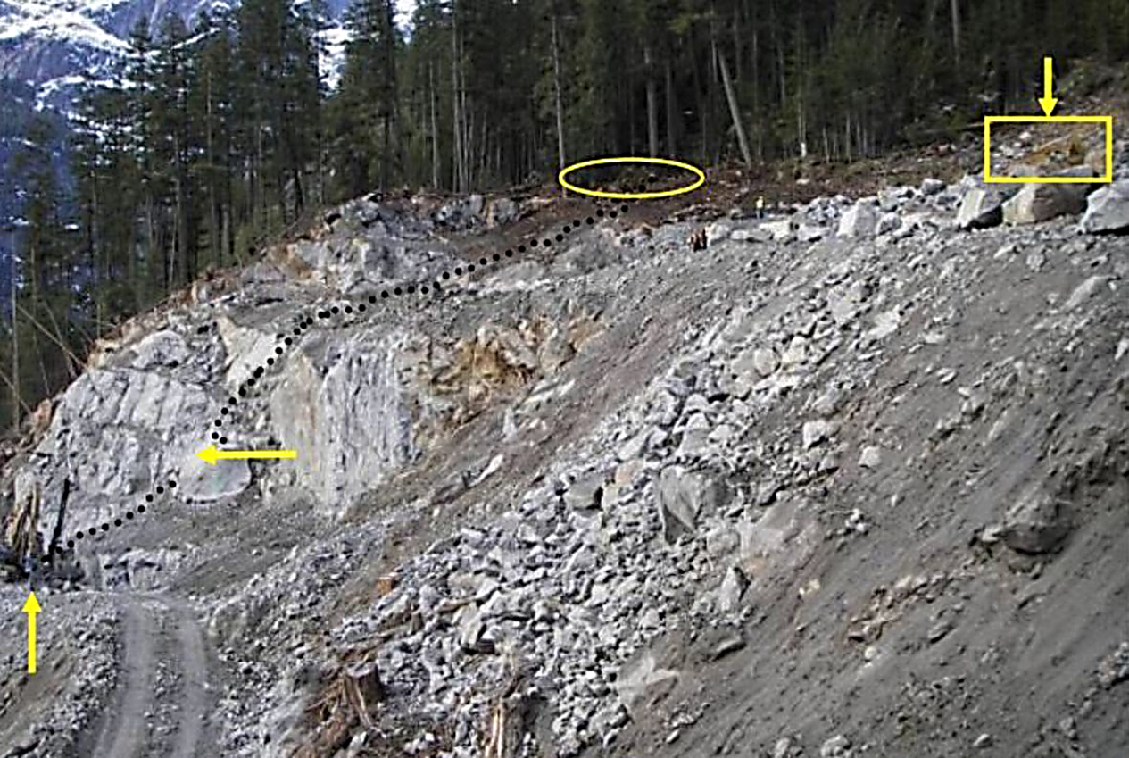
Worker Fatality: Peter Kiewit Sons Worksite 22 Feb 2009
While drilling, Sam Fitzpatrick was killed by a falling boulder on a Peter Kiewit Sons worksite on Feb. 22, 2009
Excavator equipment was allowed to keep working above Fitzpatrick, even though a boulder had fallen the day before, damaging equipment & ignoring a new safety plan.
Criminal negligence charges have been filed in the 2009 death of Sam Fitzpatrick on a B.C. worksite, charges that are unprecedented in Canada for a major multinational corporation.
The law “has teeth”!
https://www.cbc.ca/news/canada/british-columbia/sam-fitzpatrick-workplace-death-criminal-negligence-charges-1.5157579
Chapter 6.3: OH&S In Canada
13

Slide 14
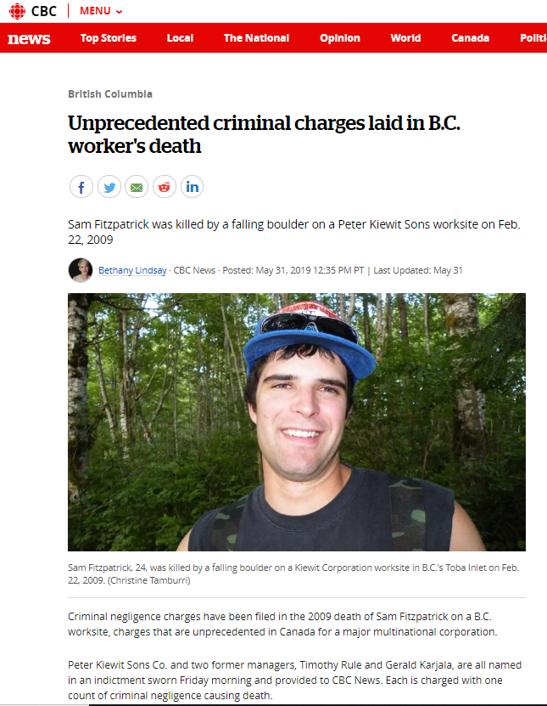
Worker Fatality: Peter Kiewit Sons Worksite 22-Feb2009
Steven Bittle, associate professor of criminology, UOttawa, described this as the most significant application of workplace safety law and the so-called Westray law.
The law, enacted in 2004, was prompted by the 1992 Westray disaster that killed 26 miners in Nova Scotia, after charges against the company and mine managers were stayed.
The legislation resulted in Criminal Code amendments that allow prosecution of corporations and their directors in workplace incidents.
"To my knowledge, there have not been charges brought against a similarly positioned corporation in Canada," Professor Bittle told CBC, referring to Kiewit's size and influence in this country.
https://www.cbc.ca/news/canada/british-columbia/sam-fitzpatrick-workplace-death-criminal-negligence-charges-1.5157579
Chapter 6.3: OH&S In Canada
14

Slide 15
What OH&S Rules & Regs Cover Engineering Practice?
Engineering OH&S Responsibilities
Canada’s Criminal Code
APEGA Engineering Act
Canada’s Labour Code
Alberta Labour Code
Alberta OH&S Reg & Code
Chapter 6.3: OH&S In Canada
15

Slide 16

OH&S Under the Criminal Code of Canada:
Criminal Code of Canada R.S.C. C-46 is a codified law for most criminal offences and procedures.
As a result of the Westray LI, the Criminal Code now states:
Duty of persons directing work
217.1 Every one who undertakes, or has the authority, to direct how another person does work or performs a task is under a legal duty to take reasonable steps to prevent bodily harm to that person, or any other person, arising from that work or task. 2003, c. 21, s. 3.
Criminal Negligence
219 (1) Every one is criminally negligent who
(a) in doing anything, or
(b) in omitting to do anything that it is his duty to do,
shows wanton or reckless disregard for the lives or safety of other persons.
Definition of duty
219 (2) For the purposes of this section, duty means a duty imposed by law. R.S., c. C-34, s. 202.
Chapter 6.3: OH&S In Canada
16
Notes:
Criminal Code of Canada R.S.C. C-46
Duty of persons directing work
217.1 Every one who undertakes, or has the authority, to direct how another person does work or performs a task is under a legal duty to take reasonable steps to prevent bodily harm to that person, or any other person, arising from that work or task. 2003, c. 21, s. 3.
Criminal Negligence
219 (1) Every one is criminally negligent who
(a) in doing anything, or
(b) in omitting to do anything that it is his duty to do,
shows wanton or reckless disregard for the lives or safety of other persons.
Definition of duty
219 (2) For the purposes of this section, duty means a duty imposed by law. R.S., c. C-34, s. 202.

Slide 17

OH&S per the Engineering and Geoscience Professions Act AB
Engineering and Geoscience Professions Act of Alberta:
Professional engineering has its own provincial legislation and is self-governing.
APEGA is the regulator that makes sure engineering and geoscience professionals in Alberta carry out their work according to the requirements in the Act.
Act 2(1): No individual, corporation, partnership or other entity, except a professional engineer…shall engage in the practice of engineering…...
Chapter 6.3: OH&S In Canada
17

Slide 18


Engineering under Alberta OH&S Act:
Act 7(1): If the Act, a regulation or an adopted code requires work to be done in accordance with a manufacturer’s specifications or specifications certified by a professional engineer, an employer must ensure that: (a) the workers responsible for the work are familiar with the specifications, and (b) the specifications are readily available to the workers responsible for the work.
Chapter 6.3: OH&S In Canada
18

Slide 19
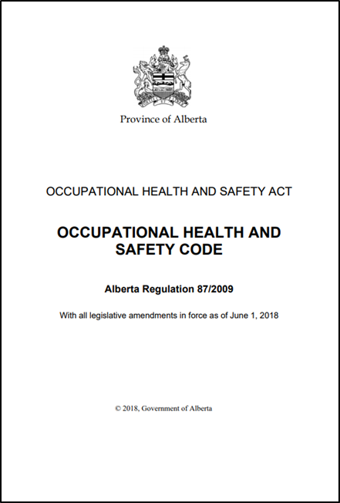
Engineering under Alberta OH&S Code:
The Professional Engineer and The AB OH&S Code:
Code has 41 parts & 543 pages
200+ references to “engineer” (latest amendments effective June 1, 2018) covering (not comprehensive):
Cranes, hoists, lifting devices, rigging, ladders
Electrical (hazardous area) classification
Fall protection equipment, scaffolding
Compressed & liquefied gas
Restraining hoses & piping,
Isolating piping
Powered mobile equipment
Elevators
Ventilation
Soil stability, excavations, underground shafts, tunnels
Mining, Oil & Gas Wells
Chapter 6.3: OH&S In Canada
19

Slide 20
Engineering under Alberta OH&S Code:
Specific responsibilities for ALL professional engineers:
Part 3 Specifications and Certifications
12 Following specifications:
An employer must ensure that
(a) … (b) … (c) … (d) equipment and supplies are erected, installed, assembled, started, operated, handled, stored, serviced, tested, adjusted, calibrated, maintained, repaired and dismantled in accordance with the manufacturer’s specifications or the specifications certified by a professional engineer.
13(1) Manufacturer’s and professional engineer’s specifications:
If this Code requires anything to be done in accordance with a manufacturer’s specifications, an employer may, instead of complying strictly with the manufacturer’s specifications, comply with modified specifications certified by a professional engineer.
Chapter 6.3: OH&S In Canada
20

Slide 21
Reporting Incidents under OH&S Code:
Employers must report:
Incident resulting in death of worker
Incident resulting in worker being admitted to hospital
Explosion, fire, or flood that has potential to cause serious injury
Collapse of crane, derrick or hoist
Collapse or failure of building or structure
Significant mining incidents (ground fall, ventilation failure, out of control vehicle, fire, serious electrical failure hoist or shaft failure, dam failure, other emergency)
Incidents with potential to cause serious injury (near misses) must also be reported
Must call OHS Contact Centre who forward to appropriate Manager
Chapter 6.3: OH&S In Canada
21

Slide 22

OH&S Prosecutions & Penalties for Failure to Comply:
Failure to comply after successful prosecution, professional engineers and organizations can face several penalties under different legal jurisdictions:
Creative Sentencing
Corporation Probation
Victim Services (in Development)
Creative Sentencing Case
2014 Suncor Tailings Facility Fatality
Funds allocated to ESRM for Tailings Safety Research
Chapter 6.3: OH&S In Canada
22

Slide 23
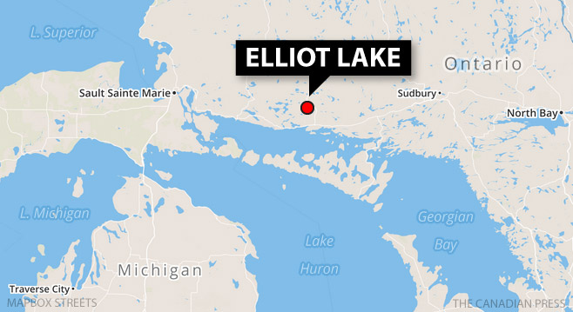
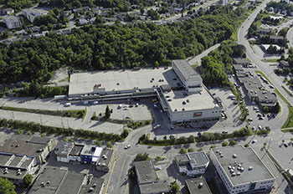
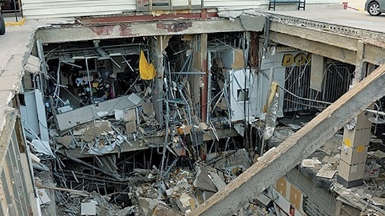
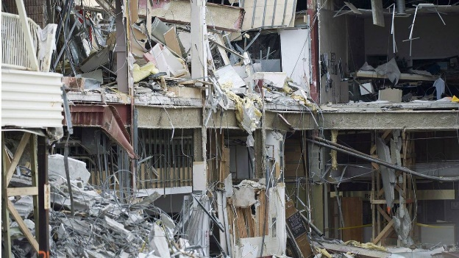
Case Study: Elliot Lake Algo Mall Roof Collapse:
In 2012, mall roof collapsed killing 2 people
Inspecting engineer claimed building was “structurally sound”, just a few weeks prior to collapse
Engineer charged two counts of criminal negligence causing death and one count of criminal negligence causing bodily harm.
Found not guilty: actions were sloppy, but not criminally negligent.
Source: Global News
Source: Maclean’s Magazine
Source: Maclean’s Magazine
Source: The Globe and Mail
Chapter 6.3: OH&S In Canada
23

Slide 24
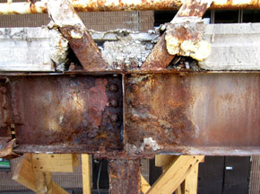
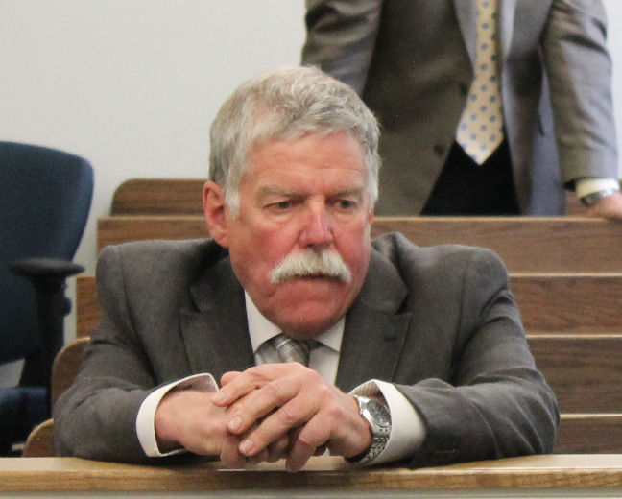

Case Study: Elliot Lake Algo Mall Roof Collapse:
Inspecting engineer made changes to report after he and his partner had signed off on it
Changes included removing photographs, and references to "ongoing" leakage.
According to the inspecting engineer, the changes were made at the request of the mall owner so he would not have issues when he applied for refinancing of the mall.
Source: Sudbury Star
Source: Maclean’s Magazine
Source: Maclean’s Magazine
Chapter 6.3: OH&S In Canada
24

Slide 25
Elliot Lake Algo Mall Roof Collapse - Immediate Causes:
Substandard Work Practices:
Engineer completed deficient inspections of the mall
Engineer did not read past inspections reports done by other engineers
Engineer did not inspect the ceiling beam welds
Substandard Conditions:
Water leaked through rooftop parking deck
Welds in the ceiling beams of the mall structure corroded
Chapter 6.3: OH&S In Canada
25

Slide 26
Elliot Lake Algo Mall Roof Collapse - Basic & Latent Causes:
Engineering and Design Factors:
Original mall design allowed for water to infiltrate through roof (inadequate technical design)
Job Factors:
Municipal officials chose not to enforce their own bylaws (organizational factors)
Inadequate maintenance of the rooftop parking deck
Personal Factors:
Engineer was more concerned about pleasing his client, the mall owner (improper motivation)
LATENT CAUSES:
Municipal officials and mall owners prioritized profit over safety; they lacked a program that built “safety as a value” within its organizations (linked to RME #1 MLCA)
Chapter 6.3: OH&S In Canada
26

Slide 27
AB OH&S Investigations Branch Reports Common “Reasons” For A Workplace Injuries:
“Common Excuses” | RME Alignment
Inadequate training/competency | 9) EC&T: an obvious conclusion
Failure to stop and re-assess when the scope of work changes | 4) MOC: an obvious conclusion
“I was only going to be up there for a minute” (so I did not take appropriate precautions to control the hazards) | 1) MLC&A: Conclusion: managers allowed workers to do work without controlling hazards, or 2) RA&MR: Conclusion: workers failed to manage the risks
Failure to learn lessons after “near misses” | 5) IRIA&A: (an obvious conclusion)
Failure to recognize and act on “signals” before the incident happens | 1) MLC&A: Conclusion: managers were not monitoring for unacceptable conditions and unacceptable practices, and/ or were not taking action to correct.
Chapter 6.3: OH&S In Canada
27
Notes:
Inadequate training/competency
9) Employee Competency and Training (an obvious conclusion)
Failure to stop and re-assess when the scope of work changes
4) Management of Change (an obvious conclusion)
“I was only going to be up there for a minute” (so I did not take appropriate precautions to control the hazards)
1) Management Leadership, Commitment, and Accountability
2) Risk Assessment and Management of Risk Conclusion: managers allowed workers to do work without controlling hazards, or workers failed to manage the risks
Failure to learn lessons after “near misses”
5) Incident Reporting, Investigation, Analysis Action (an obvious conclusion)
Failure to recognize and act on “signals” before the incident happens
1) Management Leadership, Commitment, and Accountability Conclusions: managers were not monitoring for unacceptable conditions and unacceptable practices, and/ or were not taking action to correct.

Slide 28

Summary:
The Westray tragedy led to changes in the Canadian Criminal Code to include OH&S related offences.
Engineers are responsible for adhering to OH&S requirements from a number of professional and governmental bodies.
One specific example of the responsibility of a professional engineer pertains to AB OH&S Code Part 3 Specifications and Certifications, Section 12 Following specifications.
Engineers can be held personally liable for incidents if they do not adhere to OH&S requirements and penalties are severe.
Chapter 6.3: OH&S In Canada
28

